Slide 1
MeDispenser
For the Future Me
Group C009
By Catherine, Lucien, Nithyasri & Ernest
Notes:
Have you ever forgotten to take a vitamin, or delayed a dose of medication?
Now imagine doing this not once, but several times a week, while also juggling five or more types of pills. For many elderly Singaporeans, this is the reality of their daily struggle.
Good morning assessors. I am Catherine, and these are my groupmates Lucien, Nithy and Ernest. Together, we will be addressing one of the most pressing but often overlooked issues in Singapore’s ageing population. The issue is medication non-adherence among the elderly.

Slide 2
Overview
01
03
02
04
Catherine
Nithyasri
Severity of the issue
Root causes of the issue
Proposal
Lucien
Ernest
Current Measures and Target Audience
Evaluation of the Project
Notes:
Our presentation today will follow this format. Firstly, I will share with you the severity and root causes of the issue. Lucien will then speak about our target audience, and the current measures that have been put in place in Singapore. This will be followed by Nithy who will present to you our group’s proposal. And lastly, Ernest will be sharing our project’s overall evaluation.

Slide 3
01
The Problem
Severity of the Issue
Root causes of the issue
Notes:
Let me begin.

Slide 4
What is medical non-adherence ?
Notes:
So, what is medical non-adherence?

Slide 5
Definition
It refers to a situation when patients do not follow the treatment plan or medical advice from their healthcare providers.
Notes:
Simply put, it refers to a situation when patients do not follow the treatment plan or medical advice from their healthcare providers. This can contribute to significant health decline, longer duration of hospital stay, and even premature death.

Slide 6
6 in 10
of older adult patients were unable to follow medication prescriptions, which is above the global average of 50%.
Notes:
According to a study by Singapore General Hospital, 60% of older adult patients were unable to follow medication prescriptions. This is higher than the global average of 50%. This statistic shows that the problem needs to be given closer attention.

Slide 7
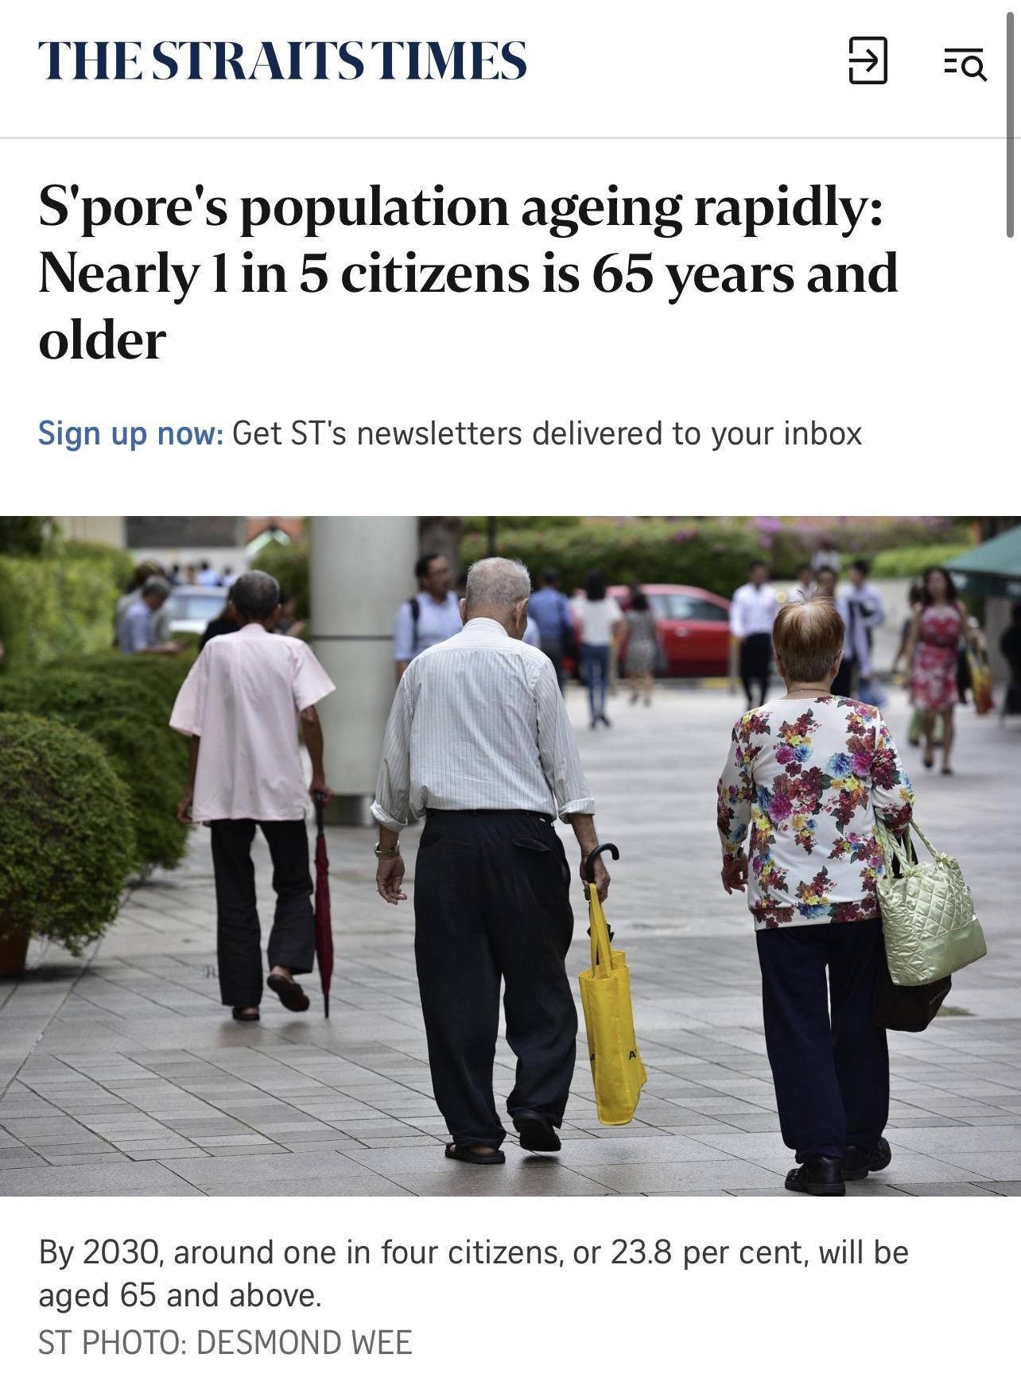
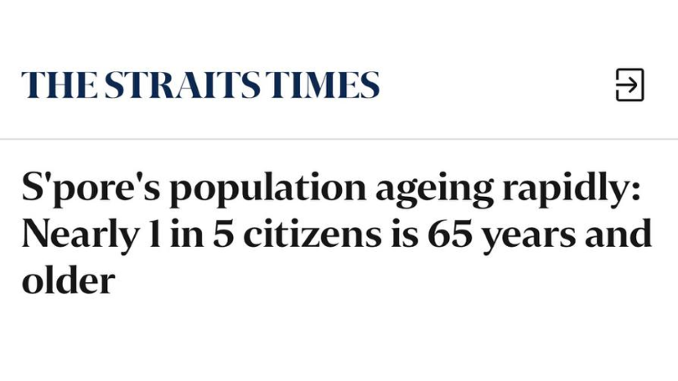

The growing problem in SG
Notes:
This issue is expected to grow due to Singapore's rapid ageing population.

Slide 8
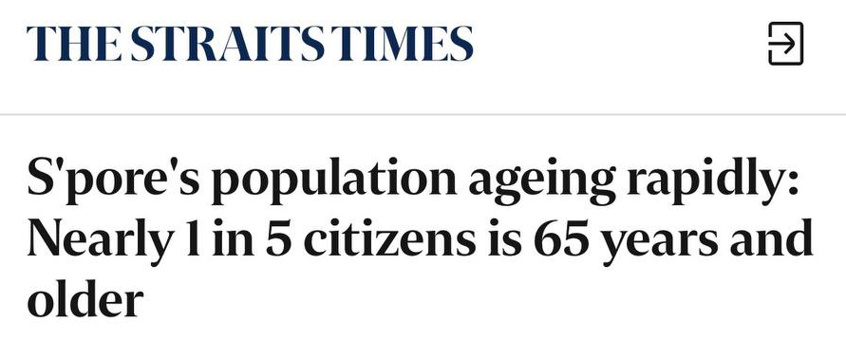
Notes:
According to a 2022 news report by the straits time, Singapore's population is aging rapidly. By 2030, around one in four citizens will be aged 65 and above. This suggests that in the coming years, more seniors will be vulnerable to the negative consequences of medication non-adherence.

Slide 9
Root causes of the issue
1. Complications in medication regime
2. Ill-equipped care assistance
3.Elderlies in charge themselves
Notes:
We’ve classified the causes into three areas. Complicated medication regime, ill equipped care assistants, and the elderlies in charge themselves.

Slide 10
1. Complications in medication regime
i. Confusing steps/instructions
Cutting the tablets in half etc.
ii. Handling multiple drugs
Polypharmacy
Complex medication schedule
Notes:
Let’s explore the first root cause, a complicated medication regime. Confusing medical instructions can easily lead to mistakes as it can be hard to remember and follow. Additionally, handling multiple drugs adds another layer of challenge. A complex schedule with different doses at different times increases the risk of missed doses, double dosing, or accidental drug-drug interactions, which can cause harmful side effects.

Slide 11
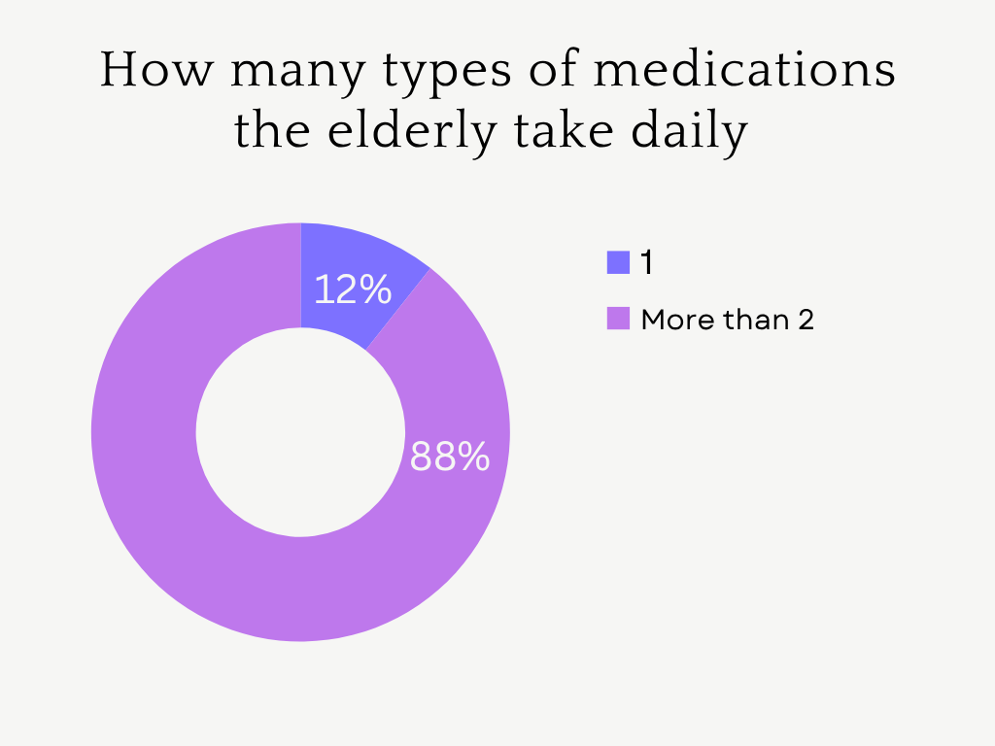
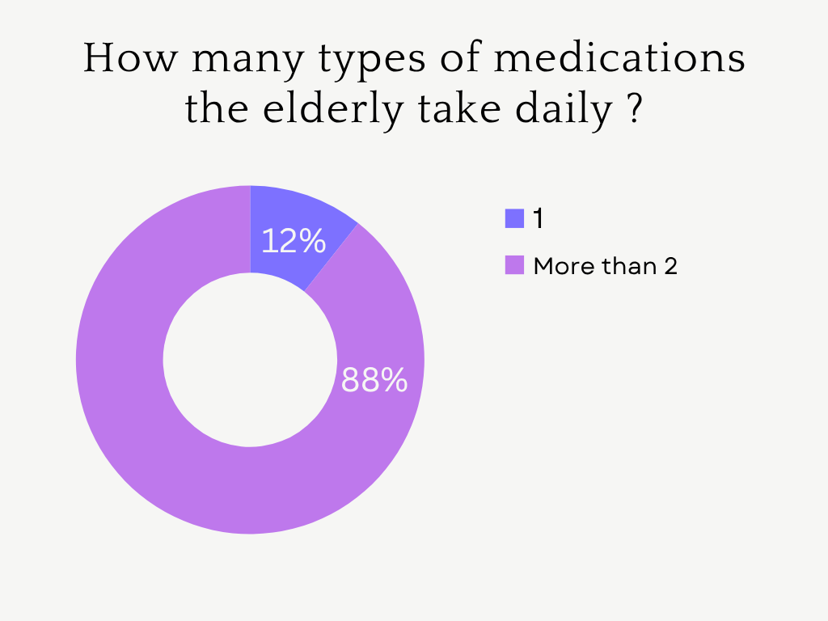
.
Notes:
In a survey we've conducted, 88% respondents reported having to take more than two medications daily.

Slide 12
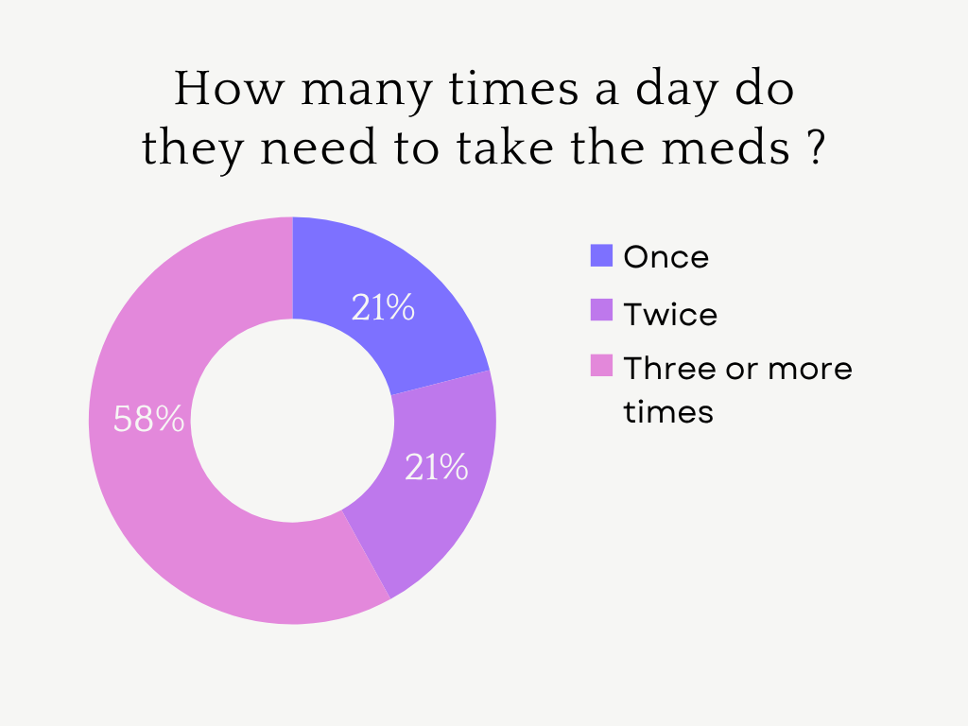
Notes:
Furthermore, while the majority need to take medication at least twice a day, a significant proportion require it three or more times daily. This highlights the increased complexity of managing multiple doses.

Slide 13
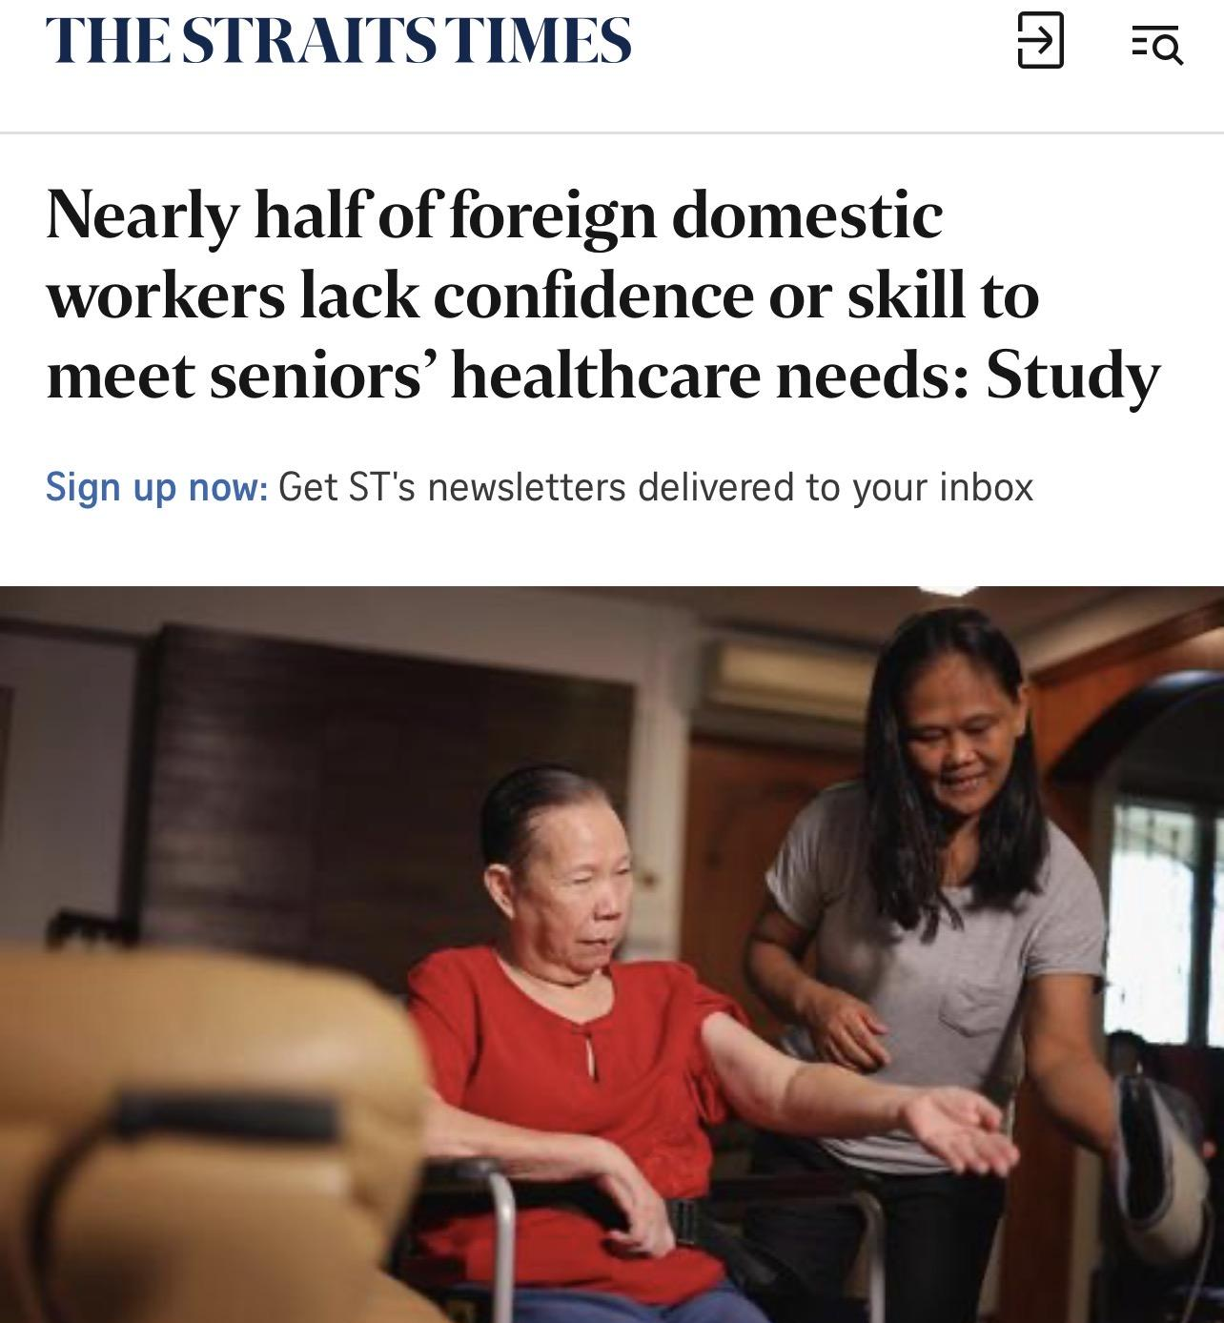
2. Ill-equipped care assistance
i. Lack of experience and confidence
Lack of knowledge and ability to administer medications.
ii. Communication barriers
Inability to understand and follow instructions that are in English
Notes:
Another key cause are care assistants who are ill equipped to ensure appropriate medication use. Many lack experience and confidence in administering medications correctly, as they often have no formal healthcare training. This leads to mistakes in dosage, timing, or missing doses altogether. Additionally, language barriers pose serious risks as most medical instructions are in English, which some caregivers struggle to understand. This might lead them to misread labels which can result in health complications for the elderly.

Slide 14
3. The elderlies in charge themselves
iii. Limited health literacy
i. Physical and cognitive challenges
Not understanding the importance of adhering to medication regime
Hopelessness
Forgetfulness, visual impairment etc
ii. Low English health literacy
iv. Intentional non-adherence
Not adhering to medication regime due to the experience of side effects
Inability to read and understand prescription medication labels in English.
Notes:
The last root cause of medical non-adherence is the inability of the elderly to self-manage their medication. Seniors who manage their own medication often face both physical and cognitive challenges.

Slide 15
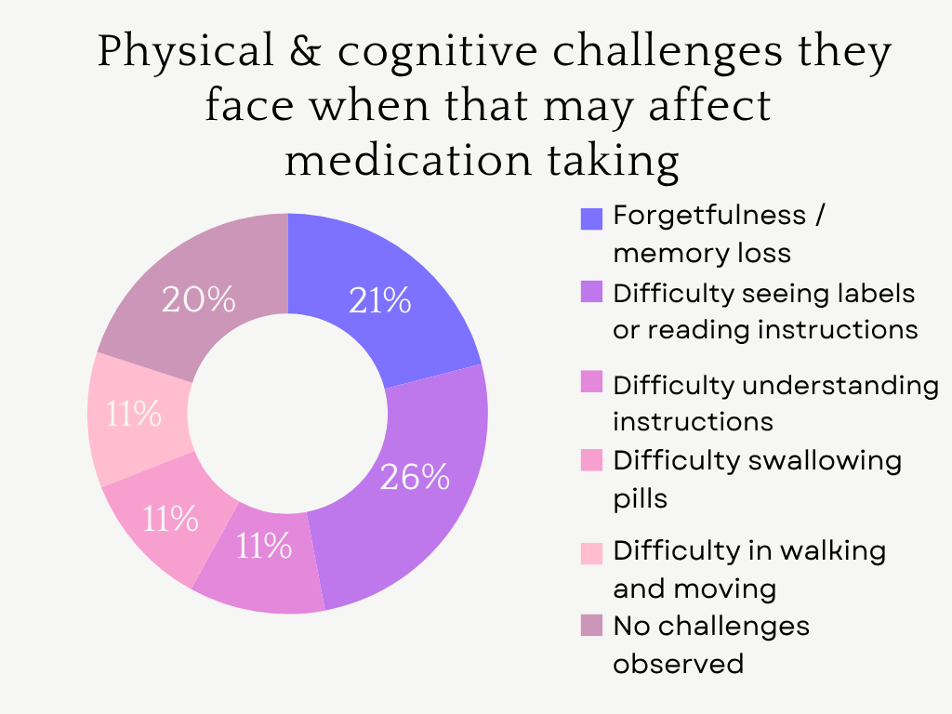
Notes:
Our survey revealed that elderly patients experience multiple difficulties, such as forgetfulness or memory loss, trouble reading instructions or labels, and problems swallowing pills.

Slide 16
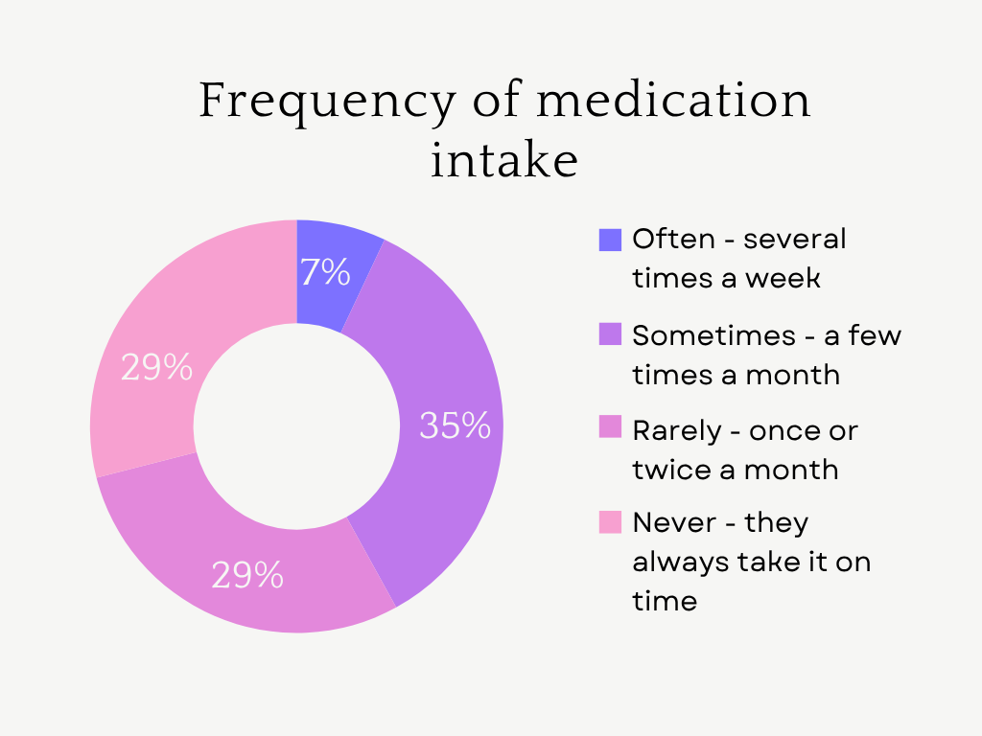
Notes:
While some elderly patients rarely forget, a significant proportion forget to take their medication on time either sometimes or very often.

Slide 17
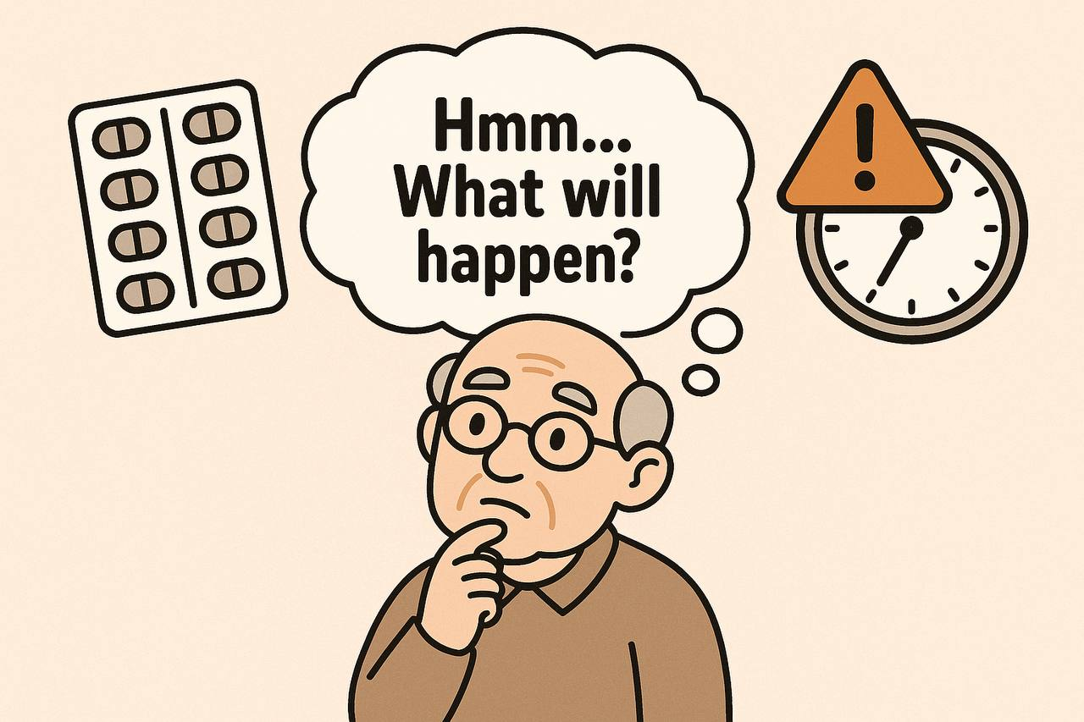
Notes:
With limited health literacy, many elderly individuals may also struggle to understand the importance of sticking to their medication schedule or the consequences of skipping doses. Altogether, these physical, cognitive, and educational barriers play a critical role in medical non-adherence among the elderly.

Slide 18
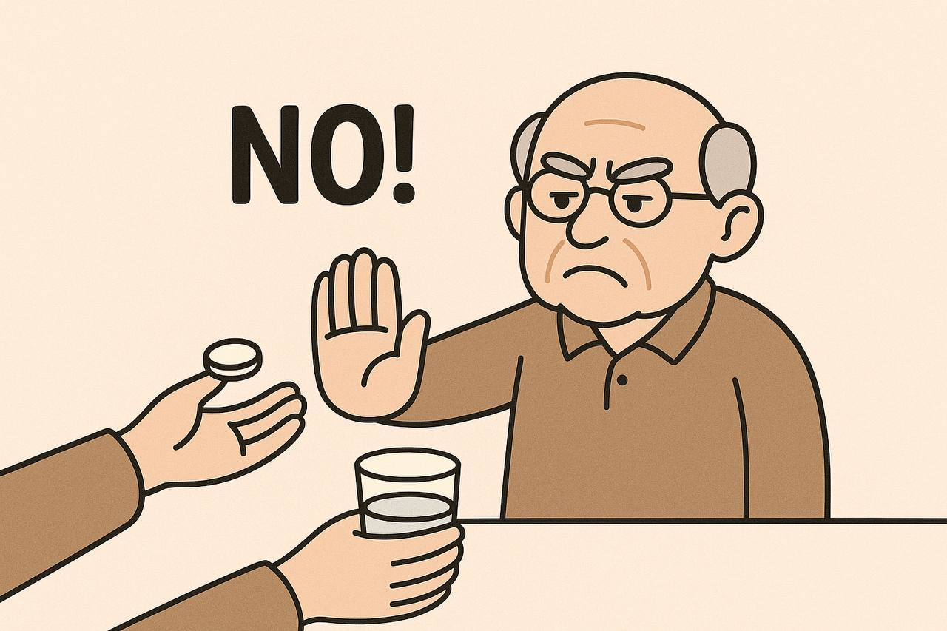
Notes:
When these effects are not addressed by healthcare providers, the elderly may stop taking their medication without seeking medical advice.

Slide 19
02
Who?
Current Measure and Target Audience
Notes:
I will now pass the time over to Lucien who will be discussing the choice of our target audience and the current measures that have been implemented in Singapore
Lucien please.

Slide 20
01
02
03
Target Audience
Current Measures
Gap Left by Current Measures ( Limitations )
Notes:
Thank you, Catherine.
Good morning assessors. I am Lucien.
As the second speaker, I will be discussing the choice of our target audience. In addition, I will also be discussing the current measures adopted to address the issue of medication non-adherence among the elderly,as well as what more can be done to fill the gap left by the current measures.

Slide 21

Target audience = >65 years old
Notes:
Let me start with who we are focusing on. Our target audience are senior citizens aged 65 and above.
Why, you might ask? This group of people are vulnerable to the effects of medication non-adherence, as shown in the next 2 slides,

Slide 22
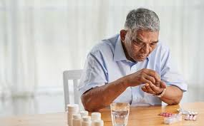
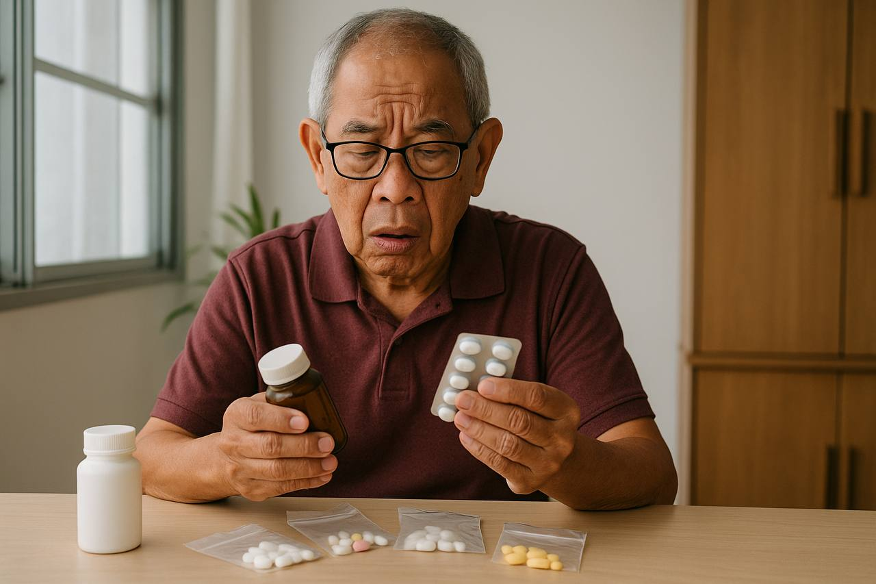
Notes:
depicting confusion before taking the medication,

Slide 23
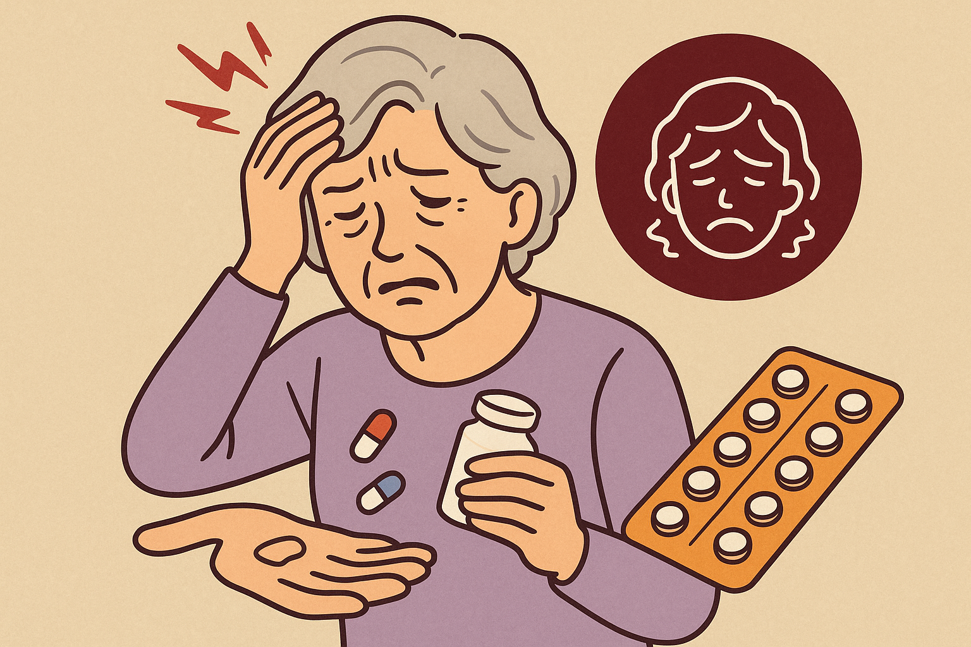

Notes:
and unexpected side effects such as headaches after taking wrong medication.
As mentioned by Catherine earlier, a significant proportion of the elderly forget to take their medication on time either sometimes or even very often.
(audience engagement - Nithy asks Lucien "How serious can that be?"
Fair question! That is indeed a concern but how serious can forgetting a few pills be? (pause) When we are talking about daily prescriptions to manage chronic and acute health conditions,

Slide 24
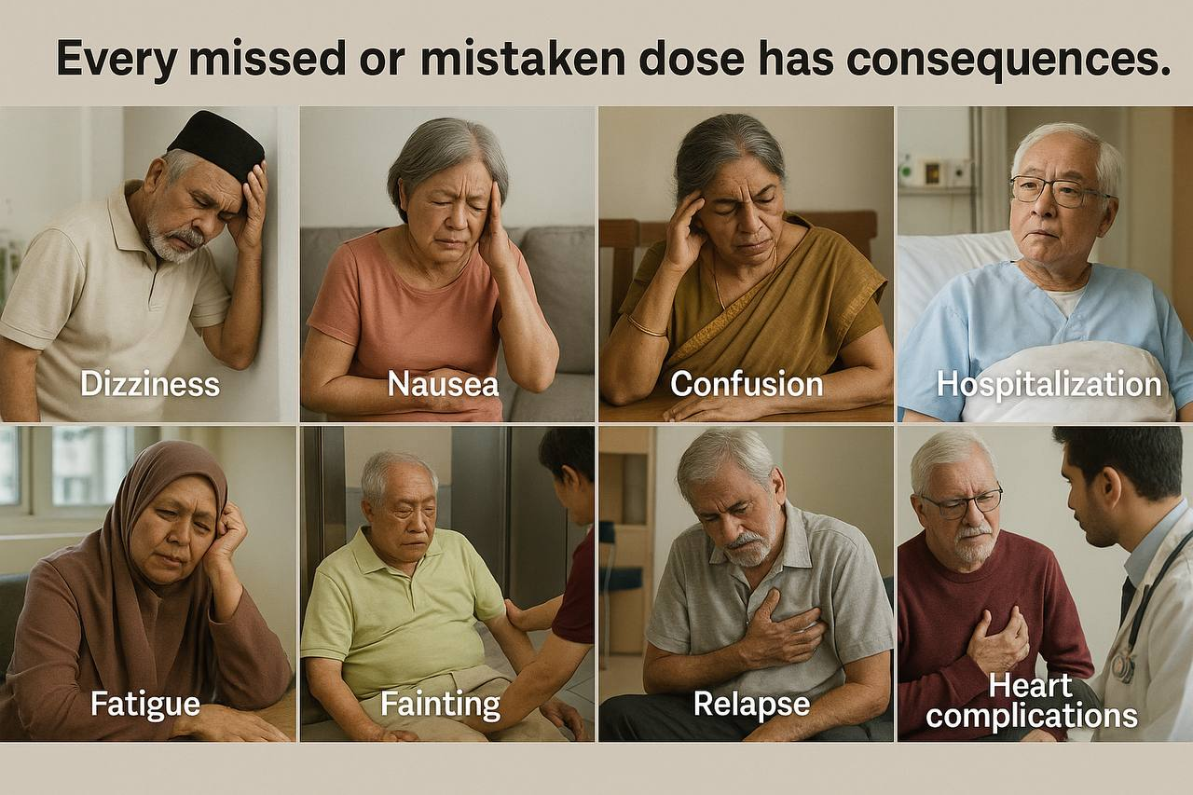
Notes:
every single missed or mistaken dose can have real and life-threatening consequences!

Slide 25
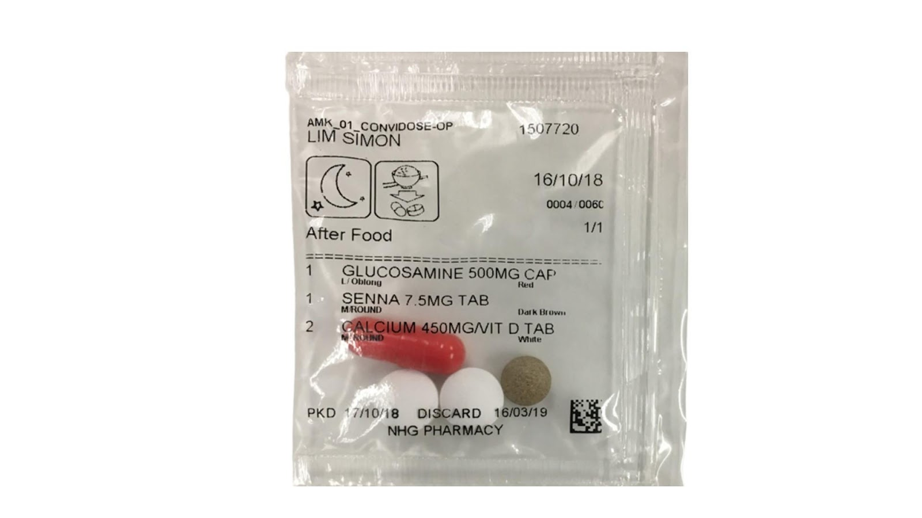
A current measure to address medication non-adherence in elderly
Convidose
Introduced by National Health Group (NHG) Pharmacy
Pre-packed sachets of medicine (according to time and specific dosage)
Notes:
Now, let us take a look at what has been done in Singapore to address the issue.
One notable initiative is the ConviDose service, introduced by the National Health Group Pharmacy.
With Convidose, medications are pre-packed according to time taken and specific dosage, as shown by the sample on the slide.

Slide 26
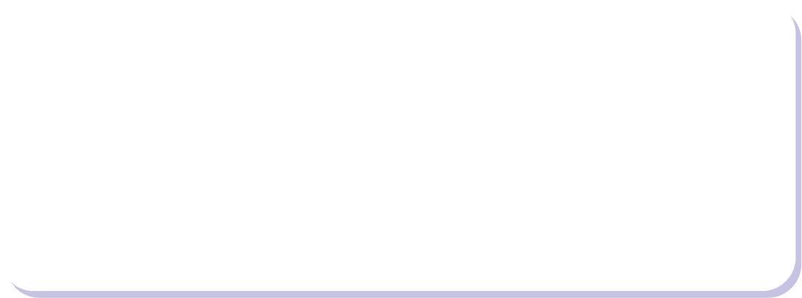
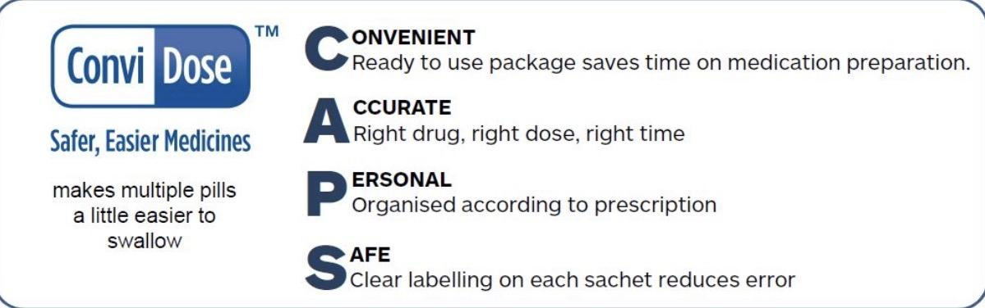
Strengths
Simplifies the process
Everything is organised for the elderly, easy to store & ready for use
Notes:
ConviDose aims to simplify what can often be a confusing or error-prone process.
With Convidose, patients no longer have to sort through multiple pill bottles.
Everything is organised for them, easy to store and ready for use.

Slide 27
Limitations
Similarly-dosed sachets may be mistaken for each other
Elderly may simply forget to take the medications or take double doses
Notes:
While these ConviDose sachets offer convenience and clarity , it also presents new challenges.
Similarly-dosed sachets may be mistaken for one another, especially if multiple time slots are involved.
In addition, patients with poor eyesight might not be able to read the fine print, or differentiate between packets, ending up relying on the colour of the medicines and other vague features which could become a serious problem.
Another factor to consider is forgetfulness.
While Convidose helps to organise the medication, it does not necessarily remind them to take it.
All these factors pose an undeniable gap that needs to be addressed.

Slide 28
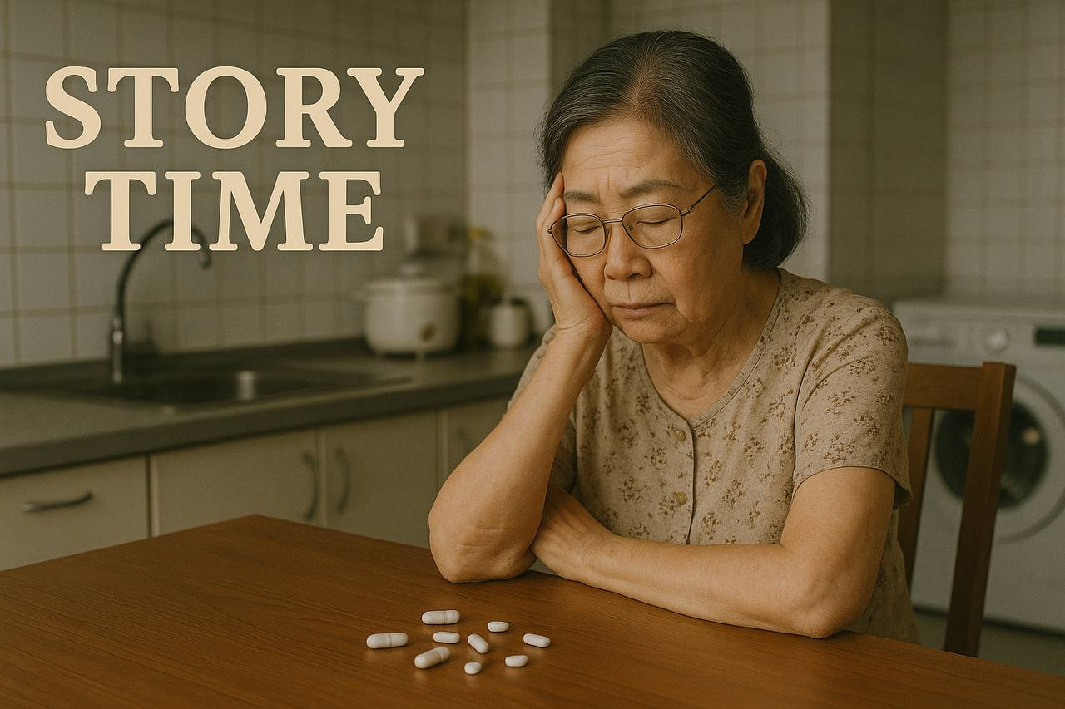
Notes:
To better illustrate the gap that needs to be addressed, let me share my experience managing my grandmother’s medication.

Slide 29
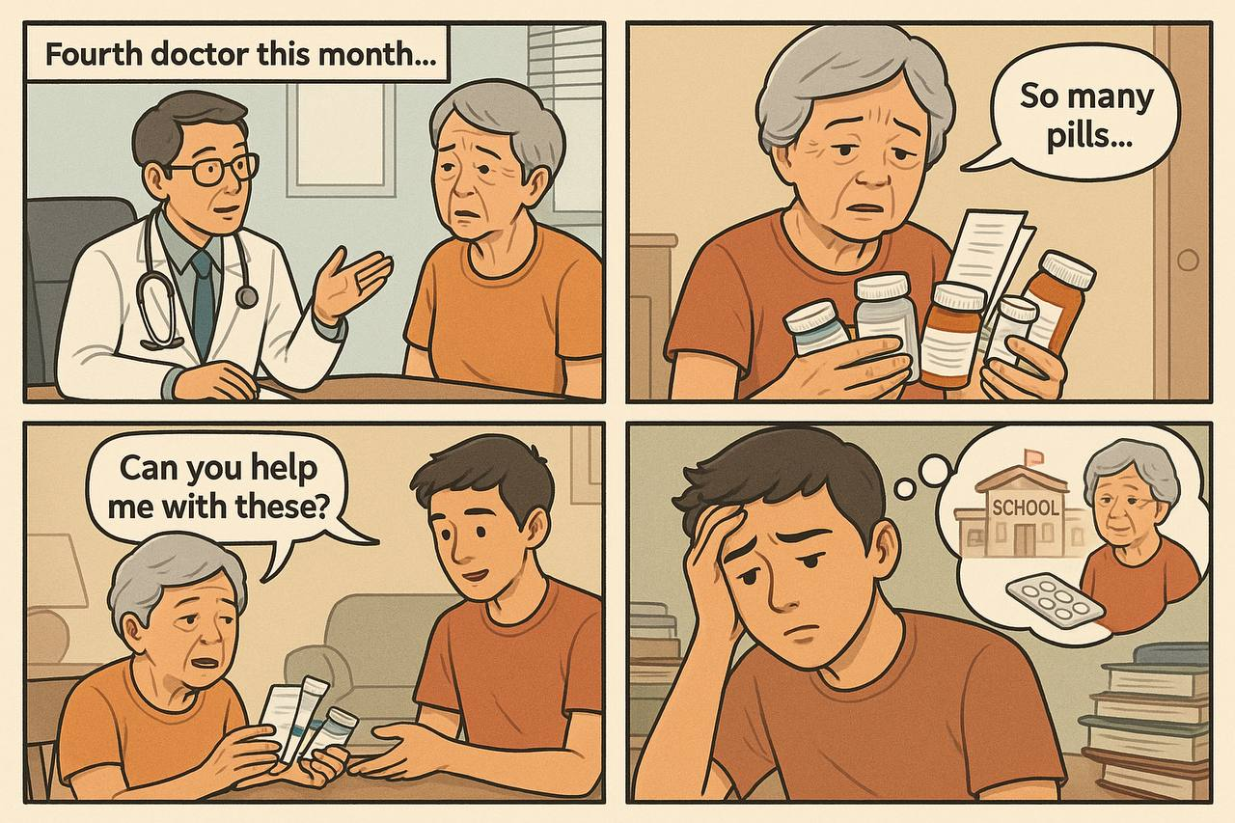
Notes:
My grandmother, who is in her early 60s, frequently goes to many different doctors for various minor ailments, and as a result gets very confused by the multiple prescriptions she receives, leaving me to be the one who has to manage her multiple prescriptions when I get home from school, causing unnecessary stress to both my grandmother who cannot differentiate between the multiple medication prescriptions, and to me who after a long tiring day of school has to sort the medications into doses for her.
This is the reality for many elderly members of society and their caregivers who are usually tired after a long day of work.
So, this begs the question, what can we do to ensure that the issue is addressed? What can we do to help the seniors take their medications safely, consistently and correctly?
Our team believes that technology can continue to play a transformative role in bridging this gap.

Slide 30

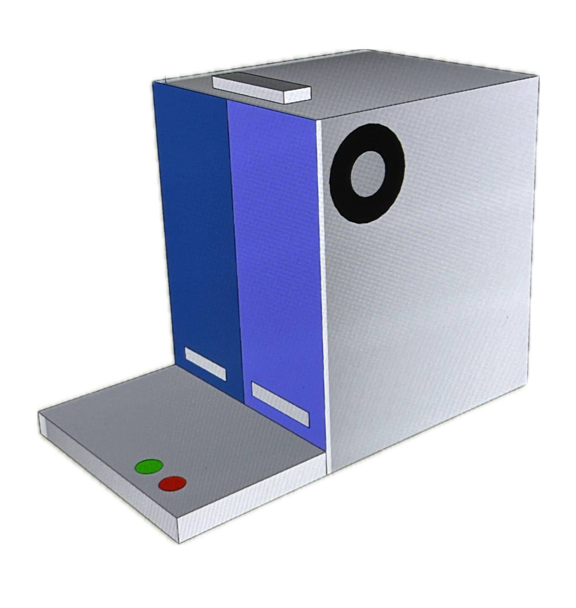
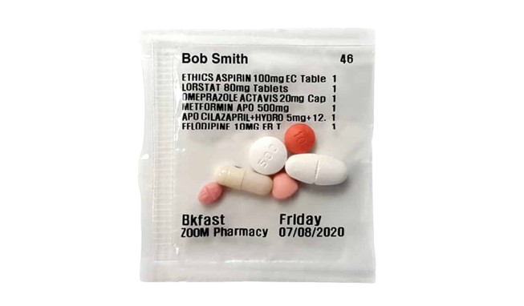
MeDispenser
Notes:
So this is where our solution comes in - introducing the MeDispenser! (pause)
So how do you say it Lucien ? Medispenser or Me-Dispenser?

Slide 31
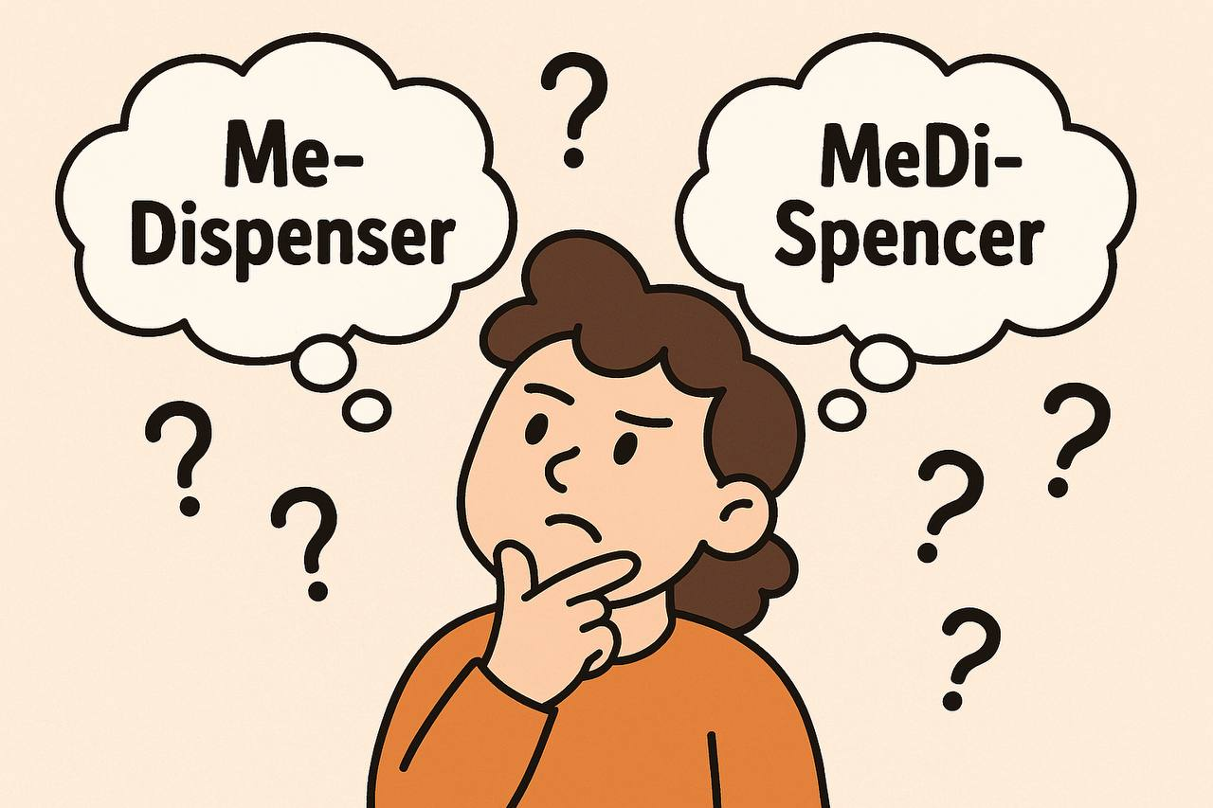
Notes:
So how do you say it Lucien ? Medispenser or Me-Dispenser?

Slide 32
Interpretation 1
Dispenser
Me
The elderly’s independence in managing their own medication
Medicine being dispensed from our product, the dispenser
Notes:
Actually.it’
The name MeDispenser carries two interpretations.
Firstly, "Me" points to the spirit of independence.
"Dispenser" refers to the tool that has been created to systematically dispense the required medication.

Slide 33
Interpretation 2
Refers to our product that dispenses the medicine
MeDi
Dispenser
Stands for “ Medicine “
Notes:
Regarding the second interpretation.,"MeDi" stands for "medicine," and keeps the focus on the medicine, which is at the heart of the issue.

Slide 34
03
Our Solution
Proposal
Notes:
Thank you, Lucien.
What drives us as a team are these questions.

Slide 35
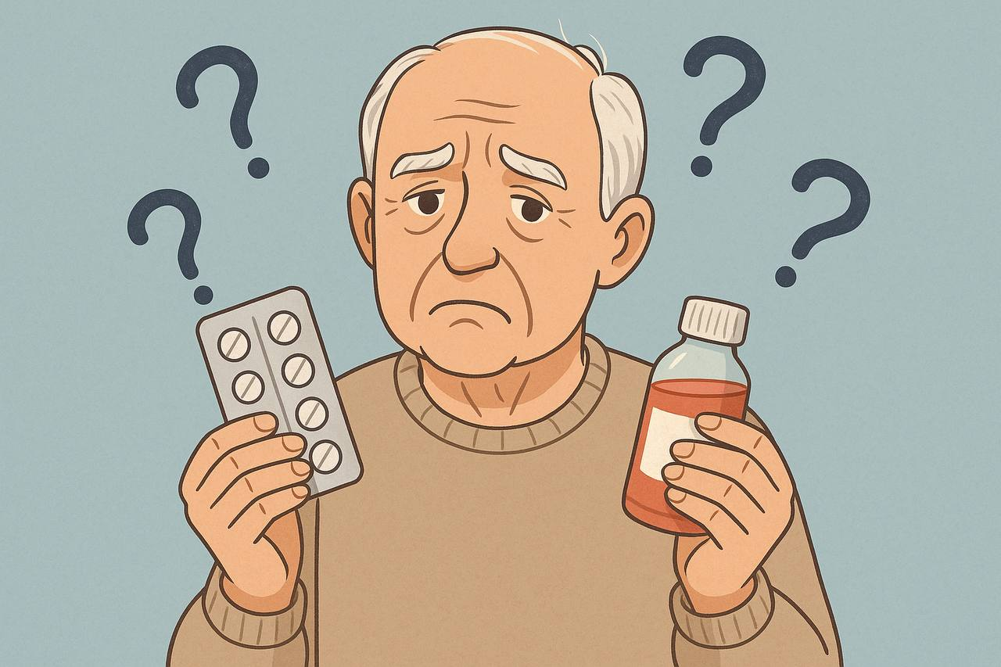
Notes:
What if we could do more than just organise pills? What if we could change the entire experience of taking medication?
And that is exactly what we have designed MeDispenser to be!

Slide 36
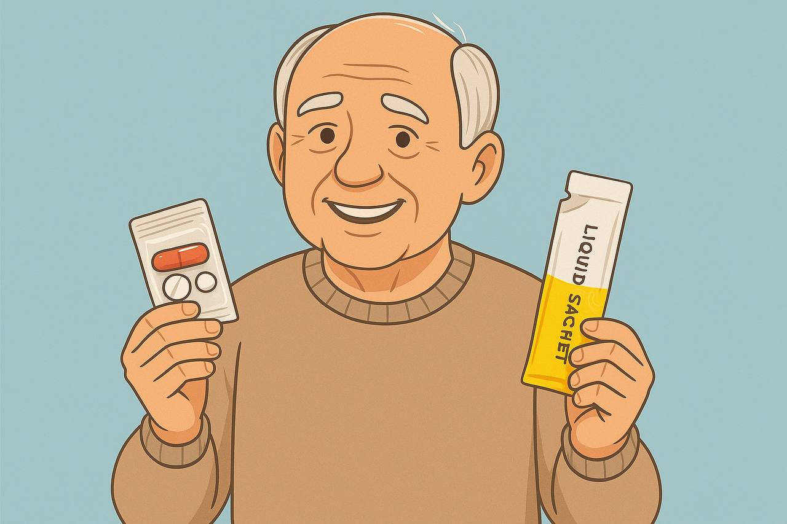
Notes:
It’s designed to go beyond simply organising pills. MeDispenser reimagines how seniors learn a new routine, take and stay consistent with it.

Slide 37
3 Part
Solution
Notes:
Good morning assessors. I am Nithy. As the third speaker I will be walking you through our group’s proposal.
Beyond just dispensing medication, MeDispenser aims to empower the seniors. Our proposal is made up of three interconnected components:

Slide 38
01
02
03
Education
Programme - MeDiLah!
Smart Dispensing Product
Product - MeDispenser
Sustained Digital Support
App - MeDi Buddy App
Notes:
education product creation and sustained digital support.

Slide 39
MeDiLah!
the educational programme hoping to cause a mindset shift
Notes:
The first part of our proposal is MediLah!,

Slide 40

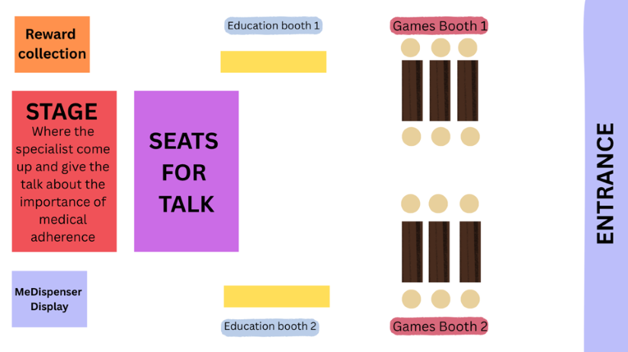
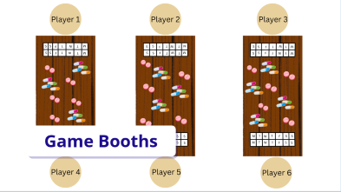
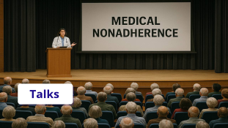


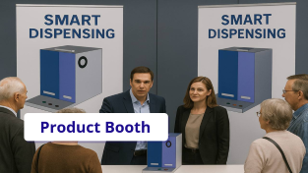
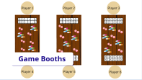
Educational Programme
Game Booths
Talks
Product Booth
Notes:
MediLah! Is a community outreach initiative. Unlike conventional medical talks held in a 'clinical, academic' setting.

Slide 41
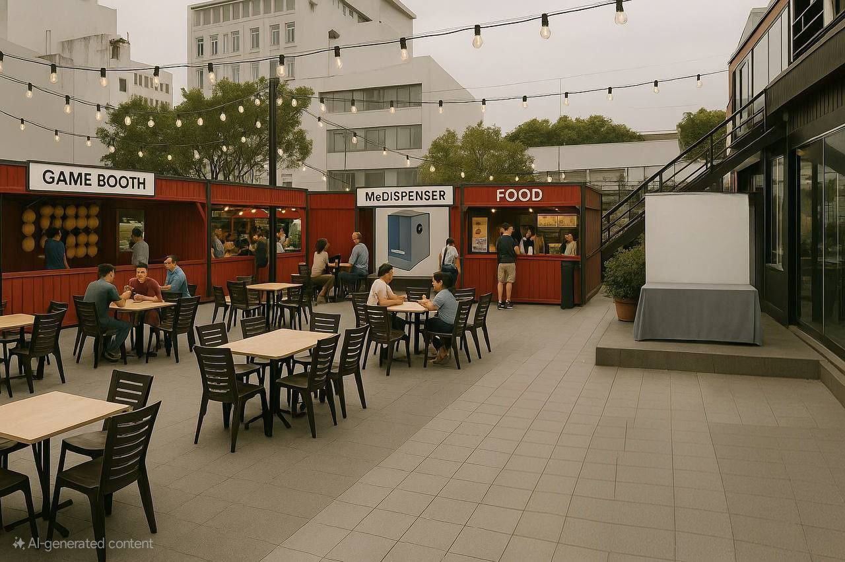

Notes:
MediLah! is held in familiar and friendly settings.

Slide 42
Pasar Malam Style
Notes:
For example the Senior Citizen's Corner. We want to give it a pasar malam-style format for familiarity, comfort and nostalgia.

Slide 43
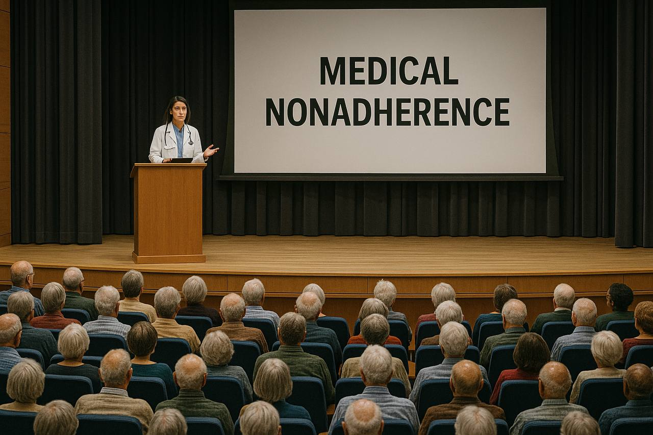
Talks
Notes:
Seniors can attend short talks from healthcare professionals,

Slide 44
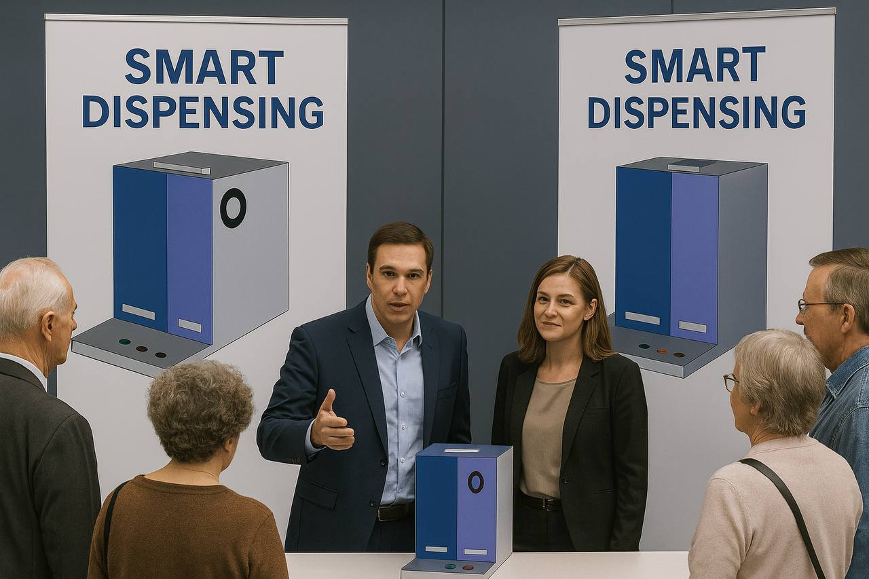
Product Booth
Notes:
explore interactive booths,

Slide 45
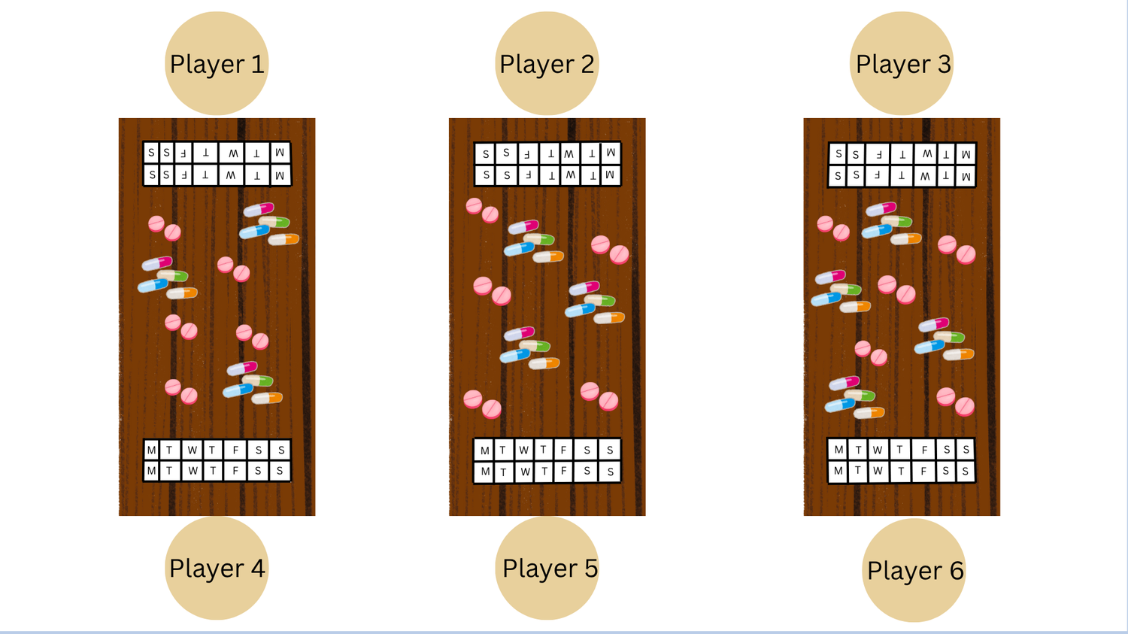
Game Booths
Notes:
and play games that highlight common medication errors, such as doubling doses or mixing pills.
Seniors can also receive immediate 'feedback' and 'advice' in a fun and memorable way.

Slide 46
Educational Programme
Raise Awareness
Clear Misconceptions
Encourage Buy In
Notes:
The aim here is simple: raise awareness, clear misconceptions, and encourage buy-in before any technology is introduced.

Slide 47
MeDispenser
the product creation that takes away the burden of organising
Notes:
The next step is helping them act on it. Meet the MeDispenser tool.

Slide 48
Smart Dispensing Product
Prepackaged Sachets
Notes:
Medispenser is a compact, smart tabletop device. It releases pre-packaged sachets — whether pills or liquid doses— at programmed times.

Slide 49
Smart Dispensing Product
Prepackaged Sachets
Labelled for Easy Checking
Notes:
Every sachet is clearly labelled with date and time, removing confusion.

Slide 50
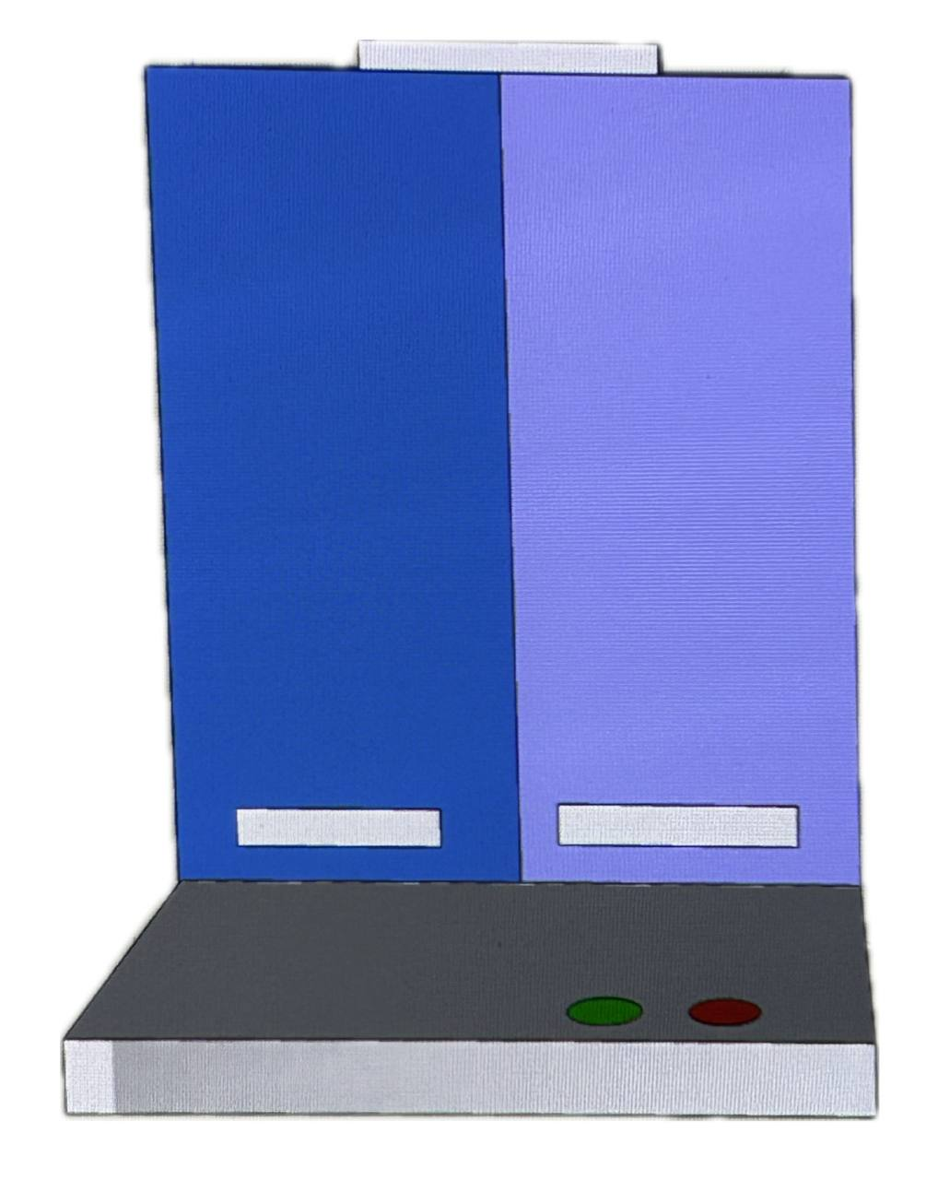
Smart Dispensing Product
Prepackaged Sachets
Labelled for Easy Checking
Programmed to Dispense on Time
Notes:
Upon its release, the satchet lands on a weighted tray that tracks whether it's been picked up.

Slide 51
Smart Dispensing Product
Prepackaged Sachets
Labelled for Easy Checking
Programmed to Dispense on Time
Accessible Records of Medication Taken Time stamps
Notes:
If it isn't, the device emits an audio alert and sends a notification to both the patient and caregiver.

Slide 52
Smart Dispensing Product
Cue
Action
Reward
Notes:
This creates a habit loop; linking the cue to the action, and reward, to reinforce consistent medication-taking behaviour.

Slide 53
MeDi Buddy App
the sustained digital support app providing technological backing
Notes:
Finally, we have the MeDi Buddy App, that offers a digital companion to the dispenser.

Slide 54
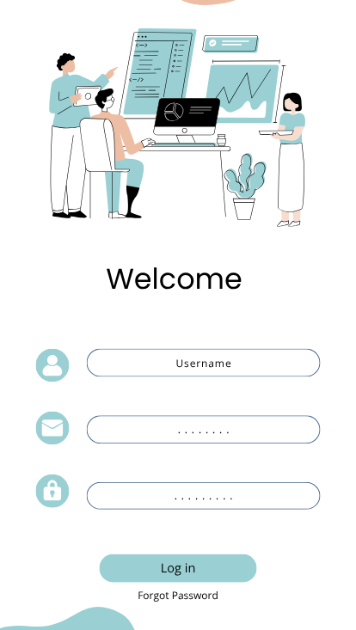
Sustained Digital Support App
Easy and Secure Log In
Notes:
The app is designed to be simple, safe and supportive.

Slide 55
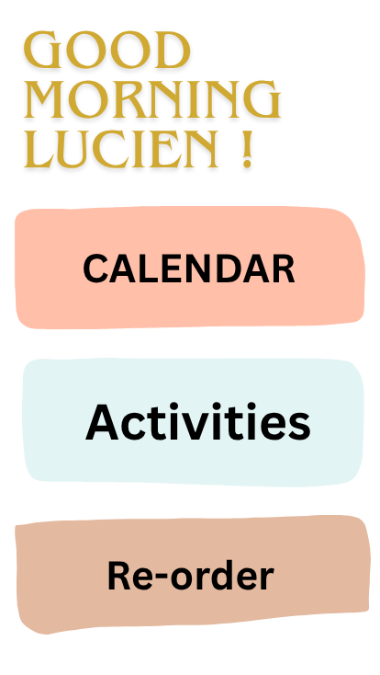
Sustained Digital Support App
Easy and Secure Log In
Notes:
MediBuddy offers an easy and secure log in.

Slide 56
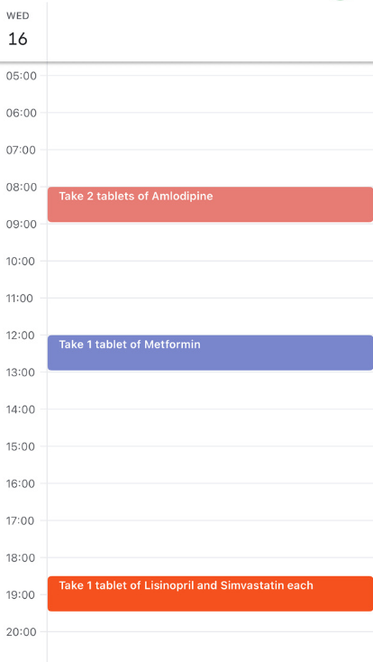
Sustained Digital Support App
Easy and Secure Log In
Live Medication Calendar
Notes:
Seniors can track their medication,

Slide 57
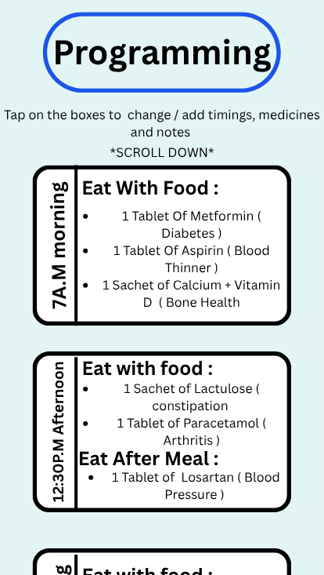
Sustained Digital Support App
Easy and Secure Log In
Live Medication Calendar
Notes:
customize it according to day or night, before or after meals

Slide 58
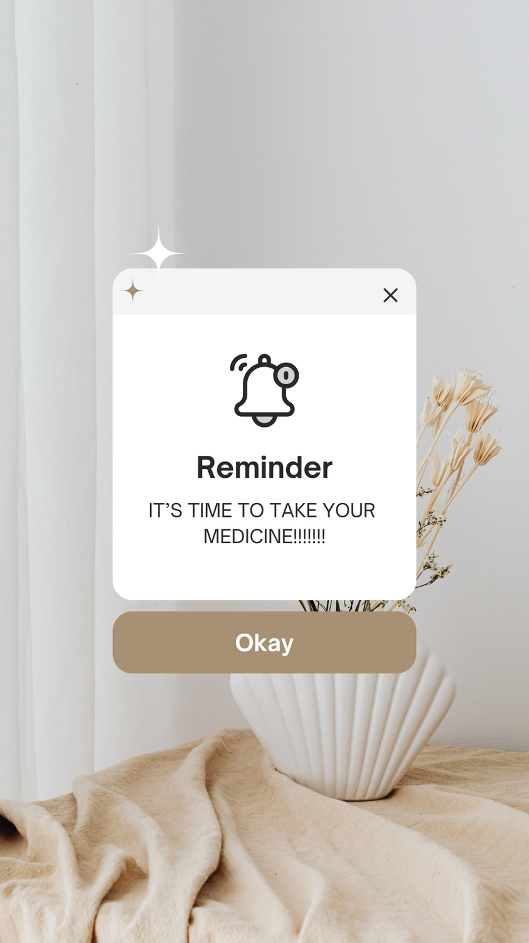
Sustained Digital Support App
Easy and Secure Log In
Live Medication Calendar
Sends Reminder
Notes:
and receive reminders.

Slide 59
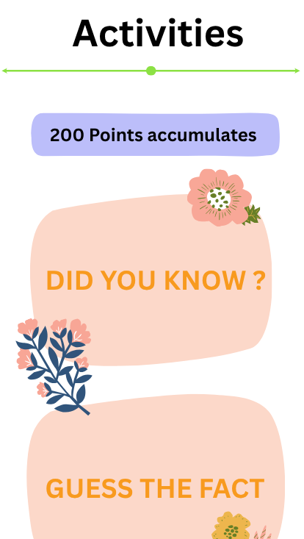
Sustained Digital Support App
Easy and Secure Log In
Live Medication Calendar
Sends Reminder
Health Quizzes and Rewards
Notes:
There’s even a special section for seniors to

Slide 60
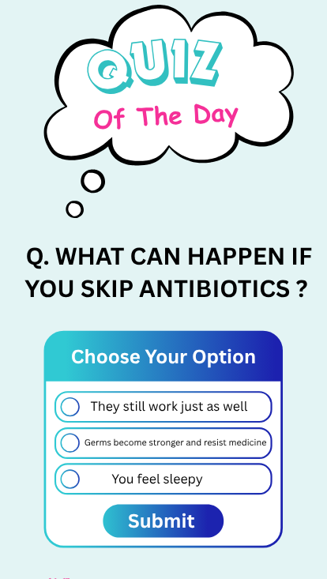
Sustained Digital Support App
Easy and Secure Log In
Live Medication Calendar
Sends Reminder
Health Quizzes and Rewards
Notes:
enjoy health quizzes,

Slide 61

Sustained Digital Support App
Easy and Secure Log In
Live Medication Calendar
Sends Reminder
Health Quizzes and Rewards
Notes:
learn fun facts and

Slide 62
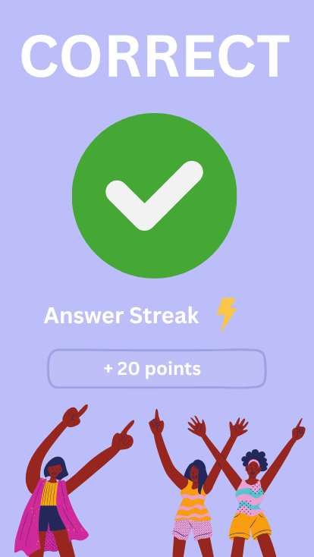
Sustained Digital Support App
Easy and Secure Log In
Live Medication Calendar
Sends Reminder
Health Quizzes and Rewards
Notes:
receive rewards.

Slide 63
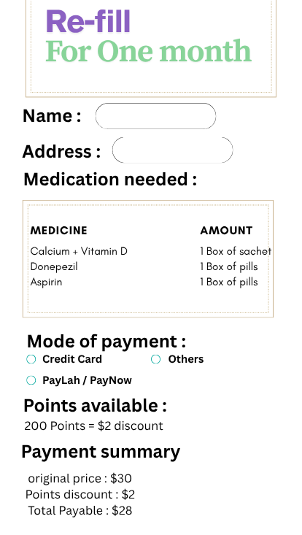
Sustained Digital Support App
Easy and Secure Log In
Live Medication Calendar
Sends Reminder
Health Quizzes and Rewards
Track and Order Refills
Notes:
The app allows users to order medication refills. Accumulated points from rewards can also be used to enjoy discounts.

Slide 64
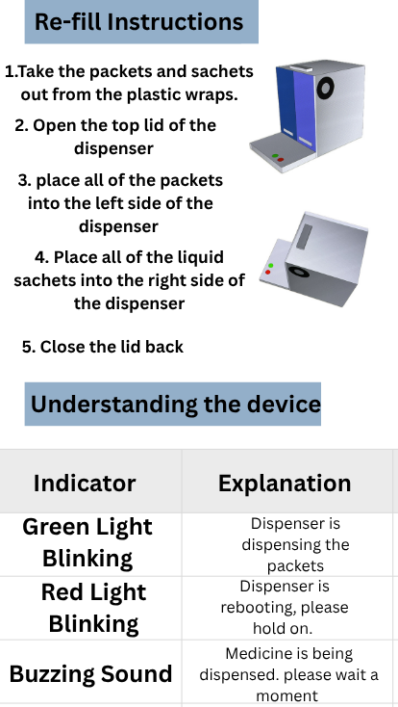
Sustained Digital Support App
Easy and Secure Log In
Live Medication Calendar
Sends Reminder
Health Quizzes and Rewards
Track and Order Refills
Manuals and Mobile Services
Notes:
For those worried about complex set ups, don’t worry! There’s an online manual you access in the app to guide you through it.

Slide 65
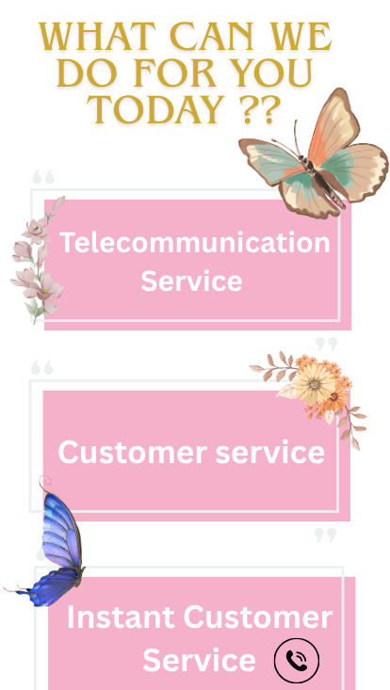
Sustained Digital Support App
Easy and Secure Log In
Live Medication Calendar
Sends Reminder
Health Quizzes and Rewards
Track and Order Refills
Manuals and Mobile Services
Notes:
That’s a great question! To report malfunction issues and clarify more specific doubts

Slide 66
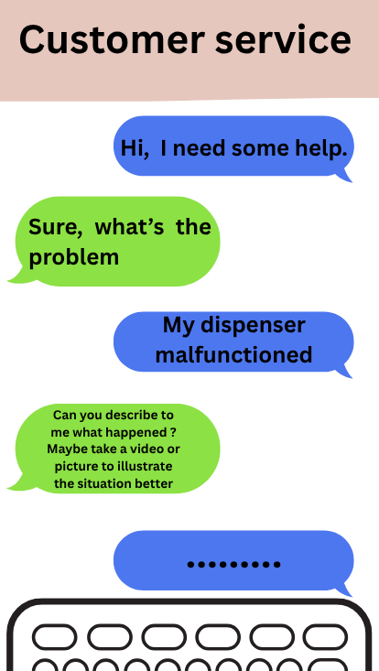
Sustained Digital Support App
Easy and Secure Log In
Live Medication Calendar
Sends Reminder
Health Quizzes and Rewards
Track and Order Refills
Manuals and Mobile Services
Notes:
you can reach out to customer service through the chatbot feature in the app.

Slide 67


Sustained Digital Support App
Easy and Secure Log In
Live Medication Calendar
Sends Reminder
Health Quizzes and Rewards
Track and Order Refills
Manuals and Mobile Services
Notes:
As a bonus feature, you can even access doctor consultations through the app - which keeps healthcare just a tap away.

Slide 68
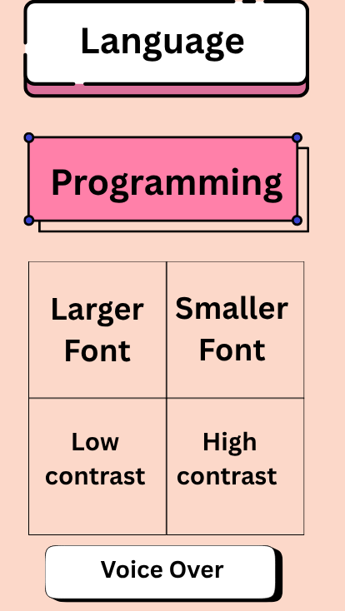
Sustained Digital Support App
Easy and Secure Log In
Live Medication Calendar
Sends Reminder
Health Quizzes and Rewards
Track and Order Refills
Manuals and Mobile Services
Interface Customization
Notes:
Seniors are also able to access voiceover options, larger text and step-by step guide making it more accessible.

Slide 69
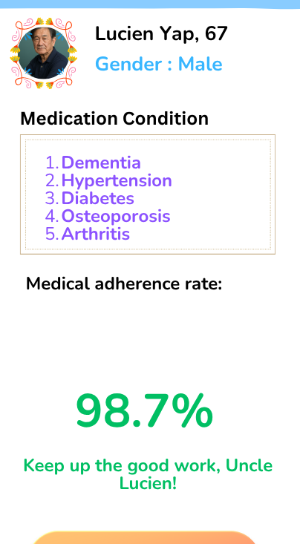
Sustained Digital Support App
Easy and Secure Log In
Live Medication Calendar
Sends Reminder
Health Quizzes and Rewards
Track and Order Refills
Manuals and Mobile Services
Interface Customization
Notes:
Importantly, the app isn’t just for seniors.

Slide 70
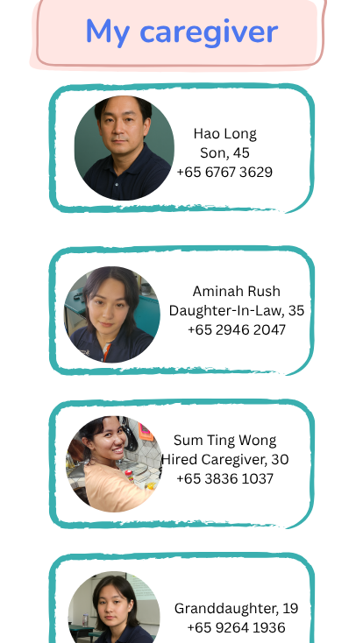
Sustained Digital Support App
Easy and Secure Log In
Live Medication Calendar
Sends Reminder
Health Quizzes and Rewards
Track and Order Refills
Manuals and Mobile Services
Interface Customization
Notes:
Caregivers can also access the app to log in and monitor progress or set reminders, ensuring seniors are never alone in their journey.

Slide 71
Awareness Gap
Daily management Gap
Long-term Habit Gap
Notes:
Together, these three components address the awareness gap, the daily management gap, and the long-term habit gap. MeDispenser is not just a device; it is a comprehensive system built around the needs of our elderly.

Slide 72
04
Why?
Evaluation of the Project
Notes:
Now, to evaluate the effectiveness of our proposal and show why it deserves to be adopted, I will pass the time over to Ernest. Ernest please.

Slide 73





01
04
02
03
The Intended Outcome and the way onward
Potential Partner
05
Subsidy methodology
Dilemma & Solution
06
Why MeDispenser
Proposed Solution

Slide 74

The intended outcome and the way forward
Reduce medication non-adherence
How?
Fine-tuned policies that take into account strengths and weaknesses
Notes:
hank you Nithy.
Good morning/afternoon assessors. I am Ernest.
As the fourth and final speaker, I will now evaluate the overall efficacy of MeDispensers, along with its strengths, weaknesses and circumstances shaping decisions that have been made, and decisions that may prospectively be undertaken. The revolutionary advent of MeDispensers in the healthcare market will indubitably facilitate medication adherence and is expected to effect decreases in non-adherence. Yet, there have been concerns over its effectiveness which have to be acknowledged due to the inextricable relationship between medication adherence and the receptivity of our target audience.

Slide 75




Dilemma:
Dispensing medication sachets
2. Dispensing medication individually on a weighted platform
Solution: Consult with healthcare professional
Notes:
In the development of our product, we have been stunned by a notable dilemma regarding the user interface of our product. In our pursuit of making a senior-friendly product, we consulted with a healthcare professional and presented two possibilities to her. The first was to equip the dispenser with a weighted platform where individual pills of medication will be dispensed onto the tray placed below. The second was dispensing readily packed disposable packets of medication combinations.

Slide 76


Proposed solution
Dispensing sachets of readily packed medication
Working together with hospitals to deliver and pack medication sachets
Notes:
The healthcare professional mentioned that the latter was a better option, by virtue of the fact that the former is replete with technology that senior citizens may be unfamiliar with, On the other hand, the latter may present logistical challenges that can be solved, and are insignificant compared to the benefits that it offers in terms of the ease of usage for senior citizens. For the replenishment of medication, one solution is to gather volunteers and have them deliver the refills. The interviewee said that the procurement of volunteers may be difficult, and working with actual hospitals or polyclinics may be a better option.

Slide 77

Potential partners
Partnership with the Health Promotion Board would establish Medispenser’s reputation
May roll out incentives for adoption such as subsidies
Notes:
Potentially, Medispensers could partner with several government agencies in Singapore, where operations may start locally.
The first example would be the Health Promotion Board in Singapore. This agency would be suitable for collaboration with us because of its role as an official agency under the Ministry of Health in Singapore which prides itself on its responsibility to promote healthy practices and the maintenance of dignified aging among Singaporeans. Partnership with the Health Promotion Board would establish Medispenser’s reputation in the health industry as an efficacious means of medication adherence.

Slide 78


Access to Medispensers
Subsidies based on income and asset wealth
Notes:
. Furthermore, possible subsidies that the government may disburse would render our product affordable to the masses, from the lower to upper echelons of society.

Slide 79

Notes:
With a combination of promotion by the health promotion board as well as internal marketing efforts, the ubiquitous adoption of MeDispensers may be realised and ensure the willingness of consumer adoption.

Slide 80

Everyone can benefit from it !
Notes:
The ability for consumers to adopt MeDispensers may be realised in procuring governmental funding to subsidise our products predicated on wealth brackets that not only take into account income, but also asset wealth to ascertain if an elderly truly requires the subsidy, and the extent to which they should be subsidised.

Slide 81

Why MeDispensers?
-Turning old is an inevitable part of life
-Cognitive decline with age would impair medication adherence
-Timeless product as medication adherence will always be imperative regardless of advancements in the chemistry of medication
Notes:
Turning old is an inevitable part of life, and some of us may experience mental decline with age that impairs medication adherence for us. Medication prescriptions are intended at coping with or mitigating illnesses, and failure to adhere to it may render the intended effect of prescriptions futile. From the cradle of civilization to the world that we know today, aging has always been an inevitable part of life. Regardless of current and future developments in AI and technology, MeDispensers will invariably be timeless and of life-saving utility across epochs and eras.

Slide 82
Thank You
MeDispenser
For the Future Me
Notes:
MeDispenser - for the future me
Thank you.

